Slide 1

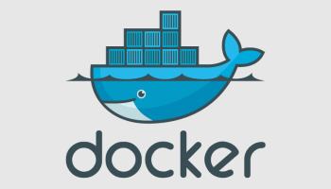
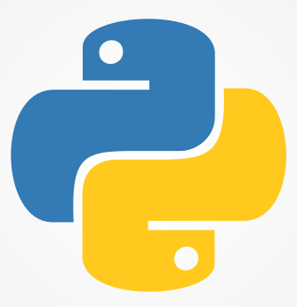
Gokaraju Rangaraju Institute of Engineering & Technology
MAJOR PROJECT (2017) TITLE: CLIENT/SERVER MODEL IMPLEMENTATION IN DOCKER CONTAINERS
GUIDE : Dr.G.R.Sakthidharan
Group members:
Amulya(13241A05N8)
Usha Sree(13241A05N4)
Mounika(13241A05M2)
Aishwarya(13241A0505)

Slide 2
AIM OF THE PROJECT
To implement client server architecture using python in docker container.
MINIMUM SOFTWARE REQUIREMENTS:
Docker tool box
Python 3.6.0
Windows 8/10 operating system
MINIMUM HARDWARE REQUIREMENTS:
4GB RAM
250GB harddisk
i3 processor

Slide 3
NUMBER OF MODULES
1.Client /Server implementation in python
2.Deploying Client/Server model in Docker.

Slide 4
MODULE- 1

Slide 5
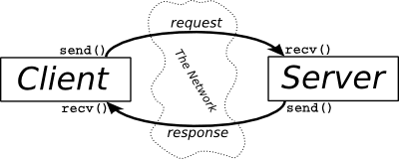
CLIENT/SERVER ARCHITECTURE
The communication between the client and server is done using sockets.
There are two types of sockets:
1.Connection oriented sockets(TCP)
2.Connection less sockets(UDP)

Slide 6
PYTHON
Python is a general-purpose interpreted, interactive, object-oriented, and high-level programming language.
Features of python :
Easy-to-learn: Python has few keywords, simple structure, and a clearly defined syntax which makes it easy to learn
Interactive Mode : Python has support for an interactive mode which allows interactive testing and debugging of snippets of code.
Portable: Python can run on a wide variety of hardware platforms and has the same interface on all platforms.
Databases: Python provides interfaces to all major commercial databases.

Slide 7
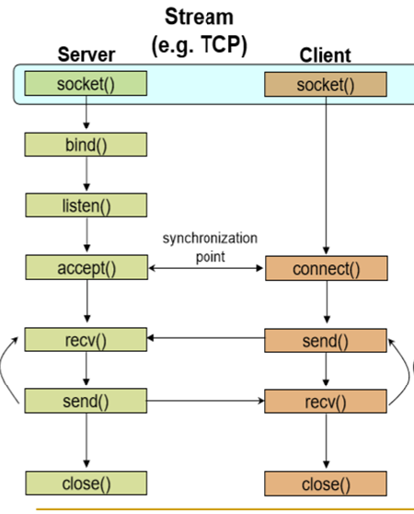
PYTHON CLIENT/SERVER FUNCTIONS

Slide 8
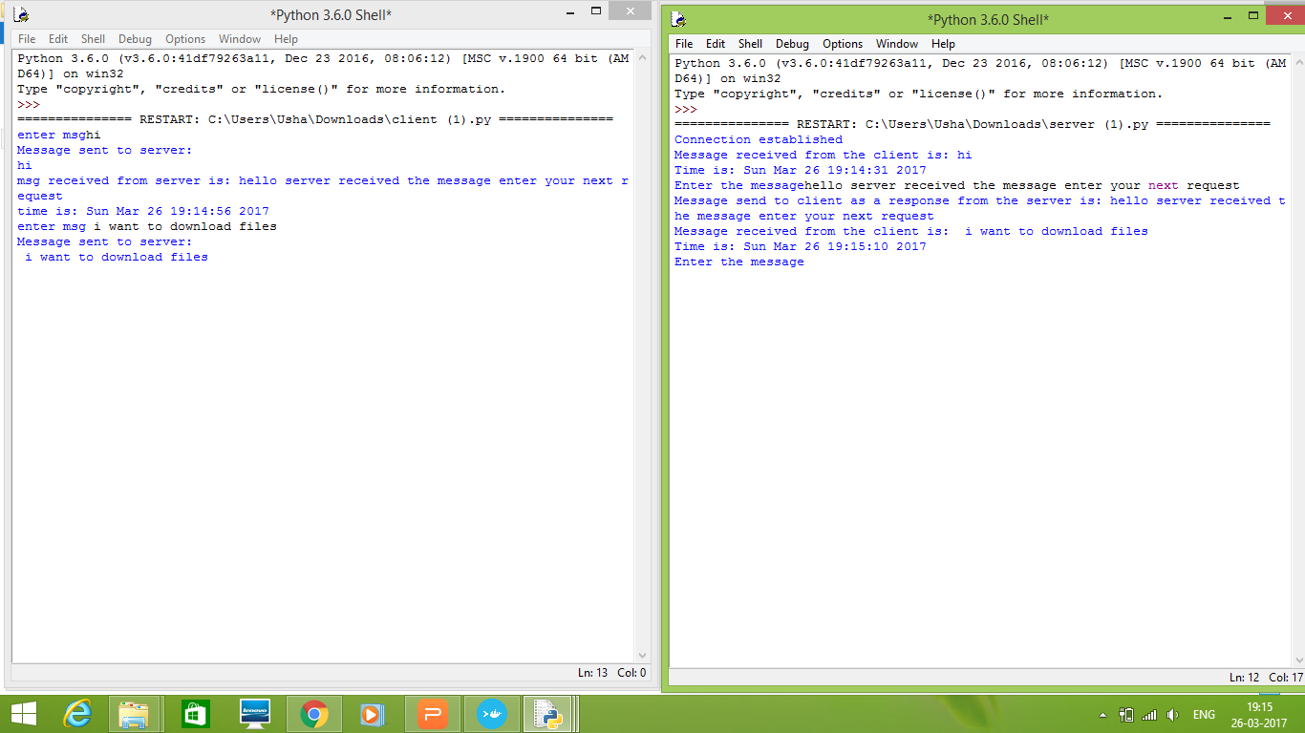
OUTPUT OF CLIENT/SERVER IN PYTHON

Slide 9
MODULE-2

Slide 10
WHAT IS A DOCKER?
Docker : Docker allows you to package an application with all of its dependencies into a complete file system that contains everything it needs to run: code, runtime, system tools, system libraries – anything you can install on a server. This guarantees that it will always run the same, regardless of the environment it is running in.
It is a latest technology released in the year 2013.

Slide 11
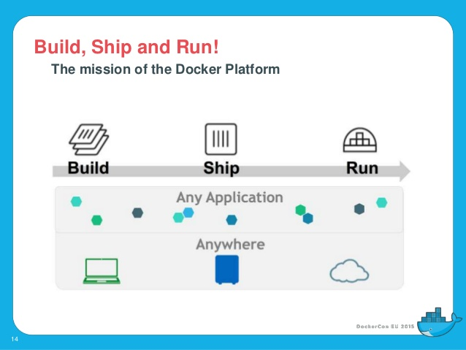
MISSION OF DOCKER

Slide 12
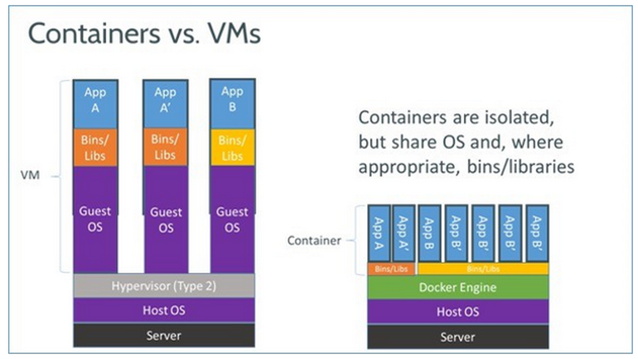
WHY DOCKER?
Docker is used because it supports virtualization concept which makes the server respond in less amount of time.

Slide 13
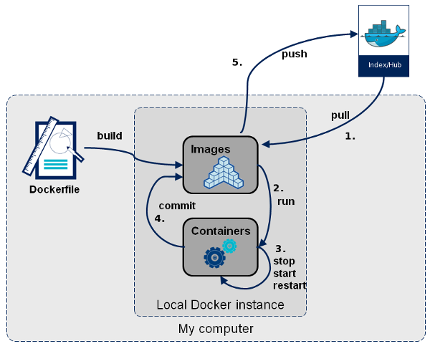
PROCESS OF DOCKER
First create a docker file
build the image for that docker file
run that image for creating a container.
we can save the created container using commit.
we can push our images to dockerhub such that any one can use them
we can pull the required images from the docker hub.

Slide 14
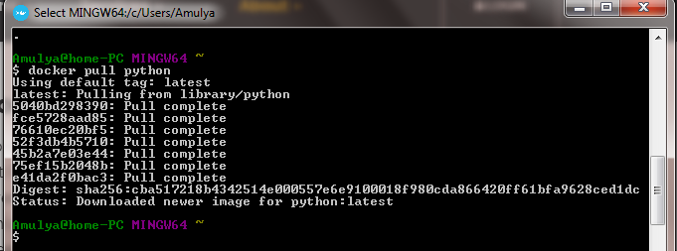
PULLING PYTHON IMAGE

Slide 15
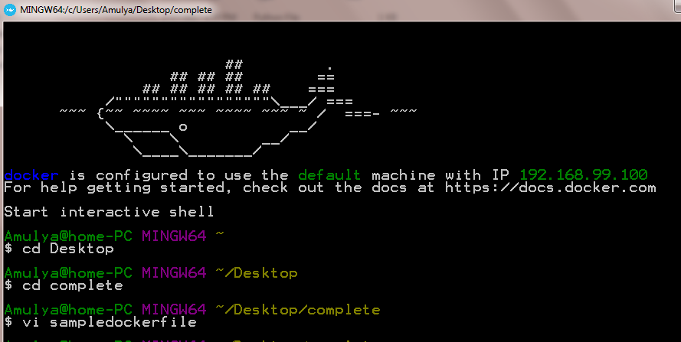
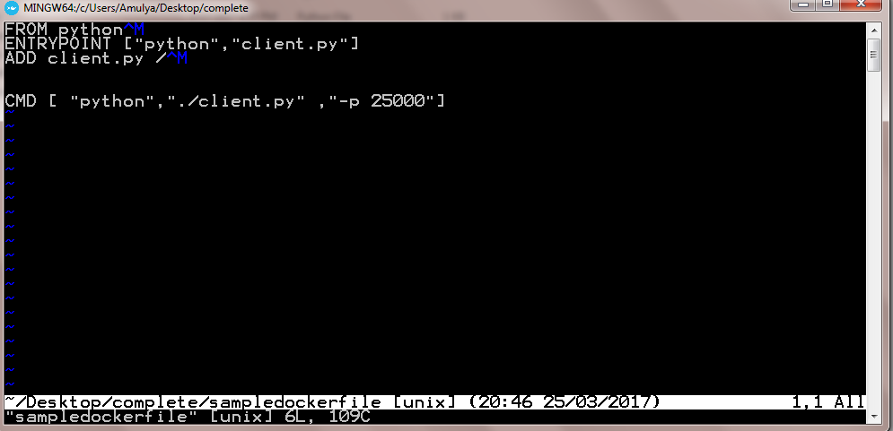
CREATING A DOCKER FILE
HOW TO OPEN A DOCKER FILE
We use vi command to open a docker file
Now the docker file is opened .To close the docker file use :wq command by pressing double escape

Slide 16
Commands needed for creating a Docker file :
FROM:The FROM instruction sets the Base Image for subsequent instructions.
Syntax: FROM <image>:<tag>
ADD: The ADD instruction copies new files, directories remote file URLs from <src> and adds them to the filesystem of the image at the path <dest>.
Syntax: ADD <src>... <dest>
ENTRY POINT: An ENTRYPOINT allows you to configure a container that will run as an executable.
Syntax: ENTRYPOINT ["executable","param1","param2"]
CMD: The main purpose of a CMD is to provide defaults for an executing container . Syntax: CMD ["executable","param1","param2"]

Slide 17
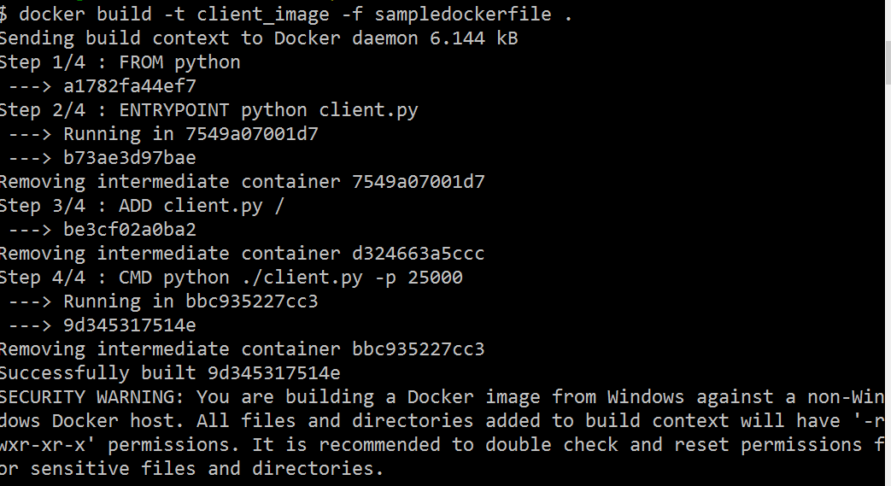
BUILDING AN IMAGE
Syntax:
docker build –t image_name –f dockerfile_name .
BUILDING CLIENT IMAGE:

Slide 18
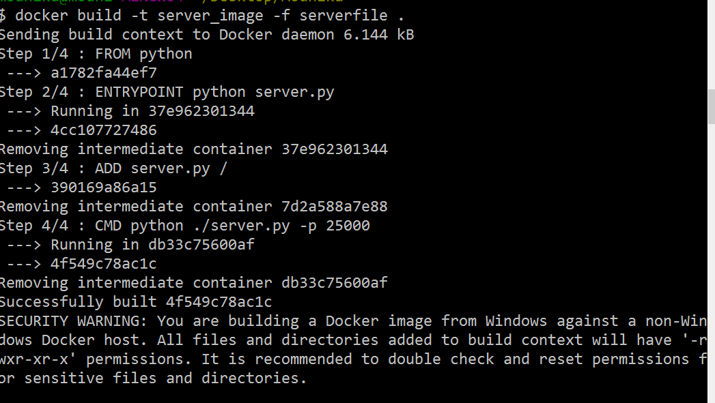
BUILDING SERVER IMAGE:

Slide 19
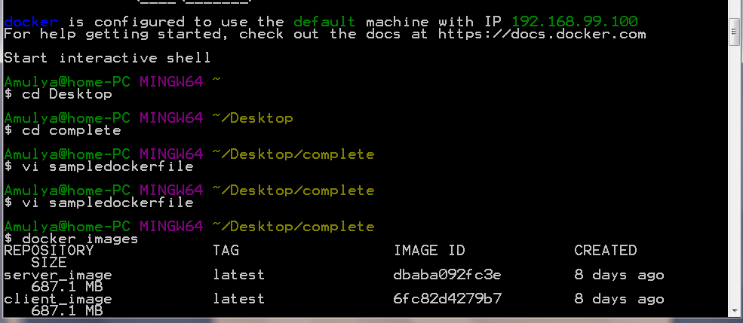
CHECKING WHETHER DOCKER IMAGE IS CREATED OR NOT USING “docker images” COMMAND

Slide 20
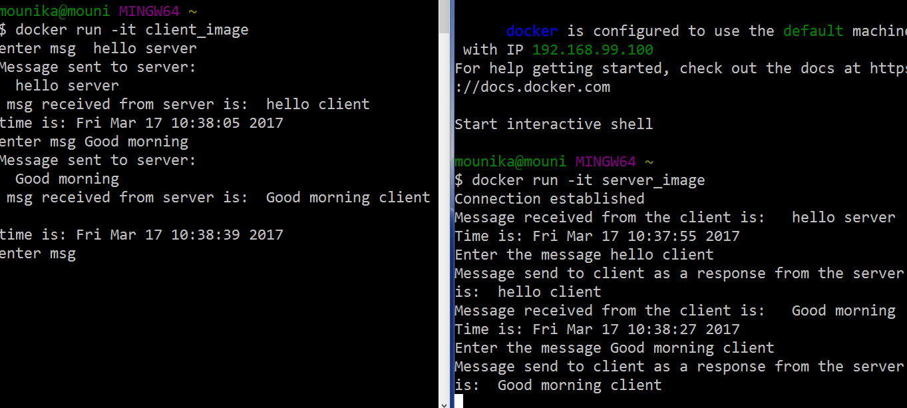
RUNNING A CONTAINER
docker run -it stands for docker run --interactive --tty
Syntax:
Docker run –it image_name

Slide 21
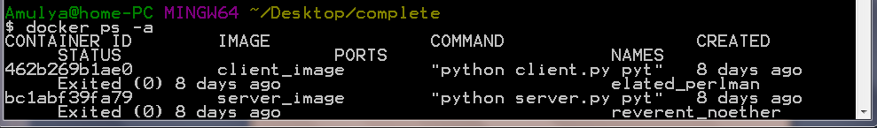
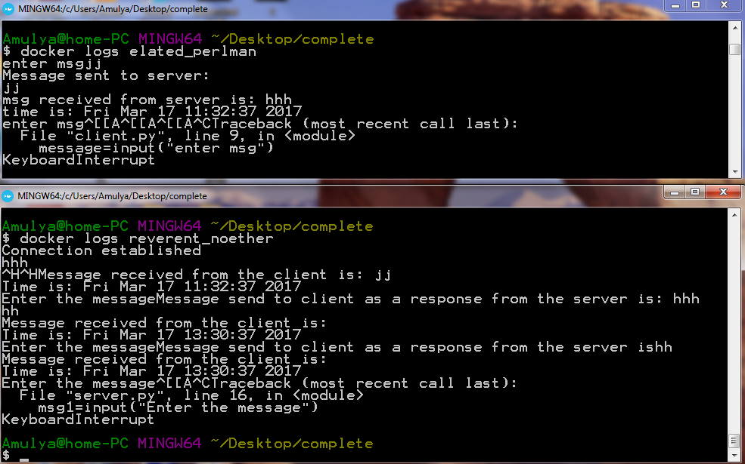
DOCKER LOGS
Syntax:
docker logs container_name
NOTE: Container name can be known using ‘docker ps –a’ command

Slide 22
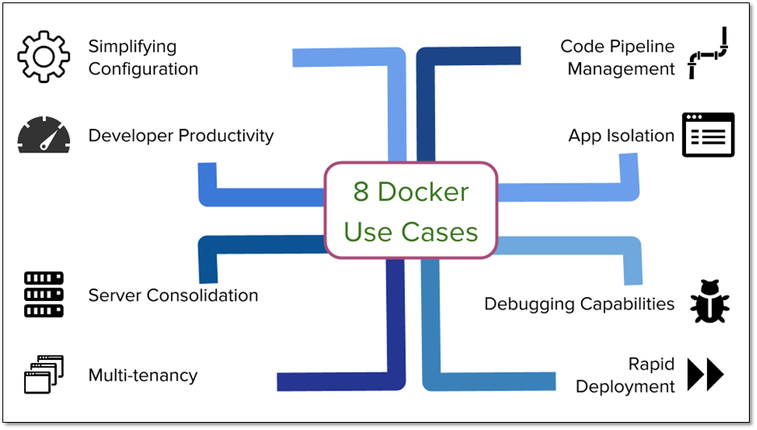
REAL TIME APPLICATIONS
Ebay simplifies application deployment.
Uber accelerates developer on boarding from weeks to minutes using docker.
BBC News Reduce CI Job Time Over 60%.

Slide 23
CONCLUSION
The biggest advantage of our project is that the client server model can be implemented in docker which can be deployed on any platform which saves maximum amount of execution time of our applications. Applications are isolated and independent of the platform being deployed on.

Slide 24
FUTURE SCOPE
We can implement this application in graphical user interface.
We can implement the client server implementation model with more than one client also.
In client server application, input is taken by the interactive mode of docker. We can take the input from the forms also.

Slide 25
REFERENCES
www.docker.com
Byron Francis, “Docker: The Complete Beginner's Guide” , 1st Edition, Createspace independent publishing platform.
Darryl Barton, “Docker: A Comprehensive Beginner's Guide”, 1st Edition, Createspace independent publishing platform.
Adrian Mouat, “Using Docker: Developing and Deploying Software with Containers”, 3rd Edition, O’Reilly Media

Slide 26


